Slide 1

DIY Interactive Floor Project
Nikola Momchilov

Slide 2
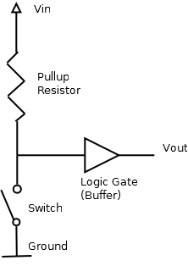
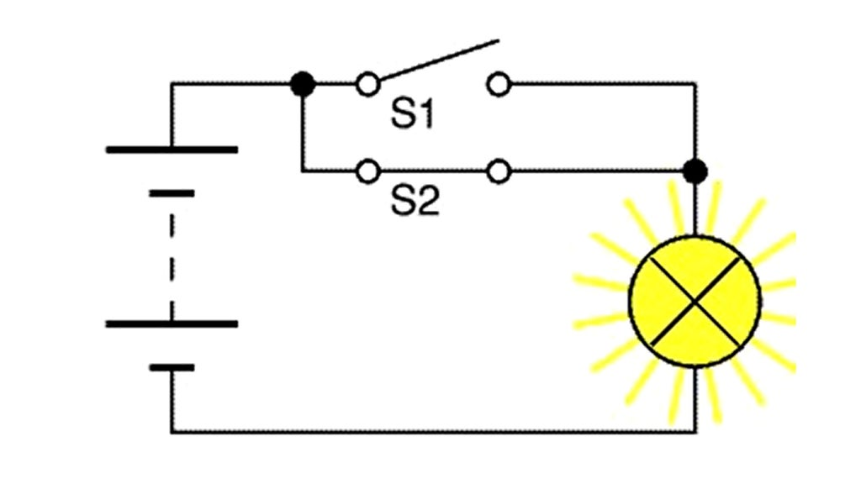
Idea/Research
The concept emerged while contemplating a proposal for stakeholders at the Glow event that emphasized visitor-powered interaction. This sparked the idea to craft a Switchplate that operates not just as a mere switch but as an engaging platform for participant involvement. creating a Switchplate working as a Switch and pull up resistors combine create the switchplate. It is typically used in combination with components such as switches and transistors, which physically interrupt the connection of subsequent components to ground. Closing the switch creates a direct connection to ground.

Slide 3
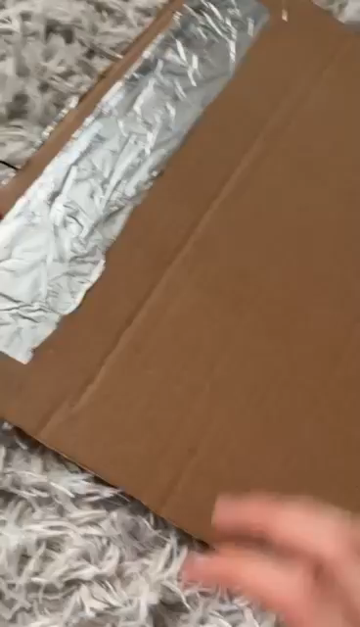
First Prototype
Learning new skills with Arduino and electronics
Materials: include cardboard, some kitchen foil, a bit of wire, tape, and a few tools like scissors and wire strippers. Make it by sticking foil on cardboard to make two special sheets, Arduino, Jumpwires Transistors and LEDs. Then, hook them up with wires. Then put another piece of cardboard in between so they don’t touch unless someone steps on it.

Slide 4
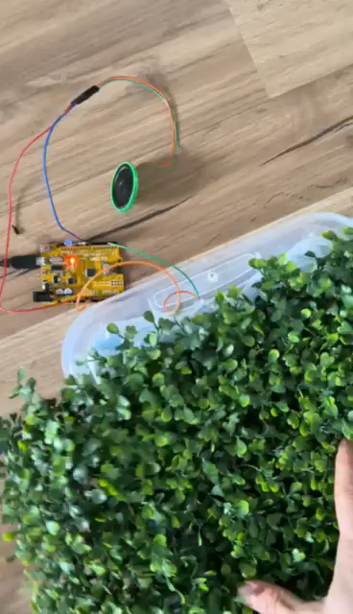
Second Prototype
For enhanced visual appeal, replacing the top cardboard layer with a transparent material would allow LEDs to be visible upon activation. This modification could elevate the project's aesthetic value and interactivity, making it more engaging for users.
Adding buzzer for sound effect.
Fake grass for implementing in the park theme. ( the design is not final)

Slide 5
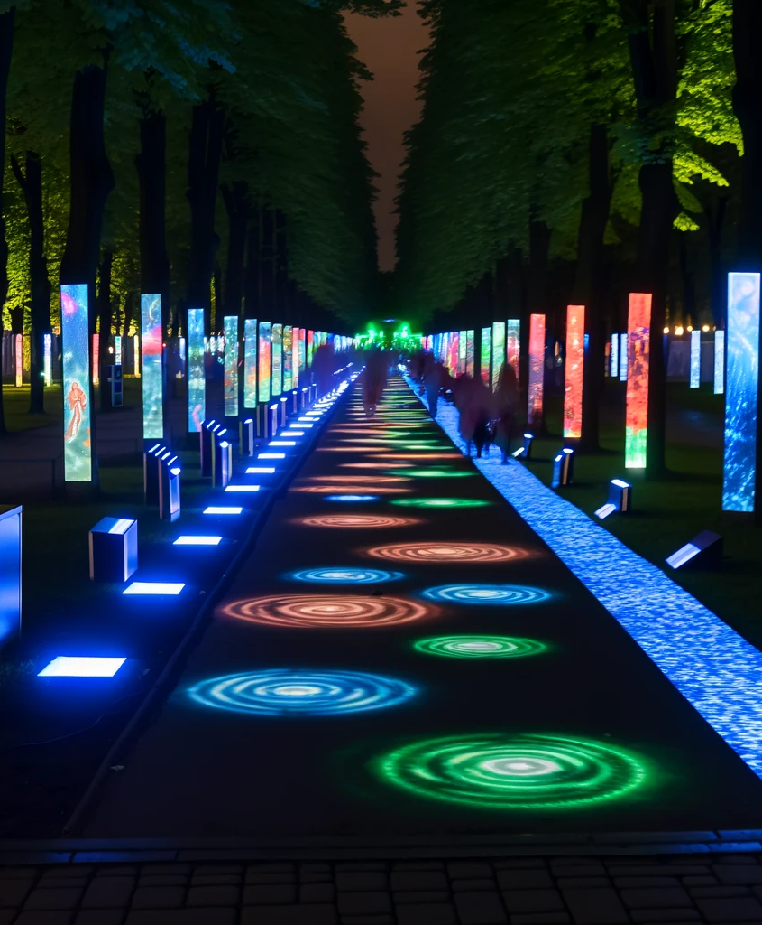
Futuristic design
Adding an RGB LED strip around the prototype's edge would not only create a stunning visual effect but also define the interactive area more clearly, inviting engagement.
To adapt the project for outdoor use, durable materials and weatherproof enclosures for the electronics are essential, alongside sustainable power sources like solar panels.
For park installation, the design should blend with the environment, using natural-looking materials and ensuring the activation mechanism is responsive to human interaction while remaining impervious to wildlife and environmental elements.

Slide 6

Conclusion
Summary: The prototype project showcases the fusion of technology with natural and narrative elements, offering a new way to experience the park during the GLOW Festival.
Invitation: Feedback is welcome and ideas to enrich this journey further.

Slide 7

Thank you!

